Slide 1
Quotes from Creative, Inventive, and Notable People
Fluency Practice
RF.3.4

Slide 2
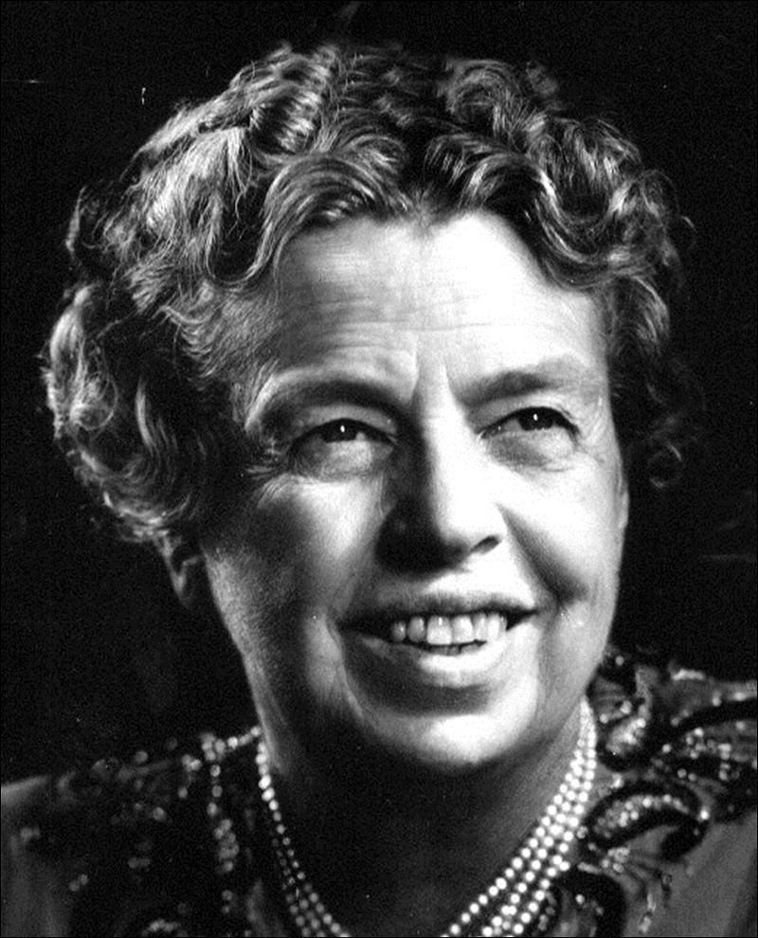
Freedom makes a huge requirement of every human being. With freedom comes responsibility. For the person who is unwilling to grow up, the person who does not want to carry is own weight, this is a frightening prospect.
Eleanor Roosevelt

Slide 3
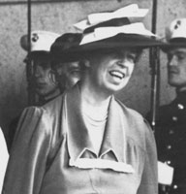
Friendship with ones self is all important, because without it one cannot be friends with anyone else in the world.
Eleanor Roosevelt

Slide 4
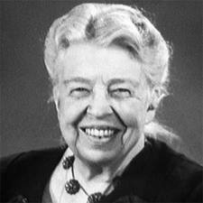
Great minds discuss ideas; average minds discuss events; small minds discuss people.
Eleanor Roosevelt

Slide 5
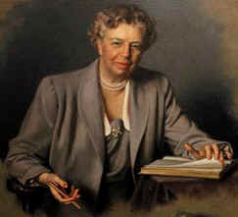
I believe that anyone can conquer fear by doing the things he fears to do, provided he keeps doing them until he gets a record of successful experience behind him.
Eleanor Roosevelt

Slide 6
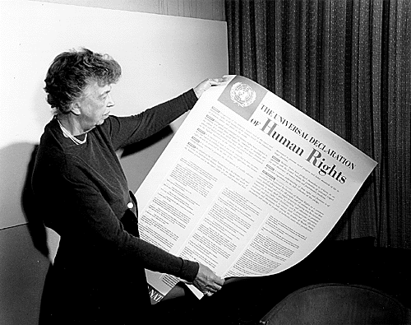
I think, at a child's birth, if a mother could ask a fairy godmother to endow it with the most useful gift, that gift should be curiosity.
Eleanor Roosevelt

Slide 7
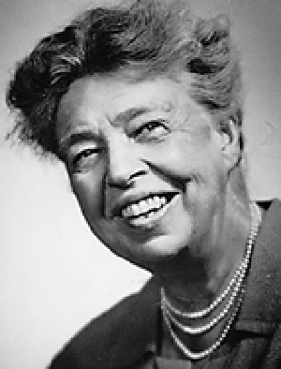
In the long run, we shape our lives, and we shape ourselves. The process never ends until we die. And the choices we make are ultimately our own responsibility.
Eleanor Roosevelt

Slide 8
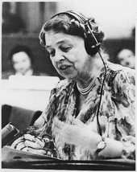
It is not fair to ask of others what you are not willing to do yourself.
Eleanor Roosevelt

Slide 9
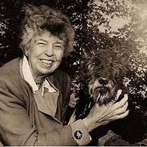
It isn't enough to talk about peace. One must believe in it. And it isn't enough to believe in it. One must work at it.
Eleanor Roosevelt

Slide 10
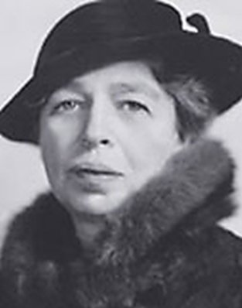
No one can make you feel inferior without your consent.
Eleanor Roosevelt

Slide 11
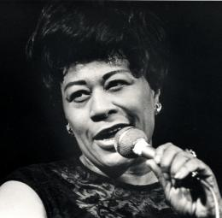
It isn't where you came from, its where you're going that counts.
Ella Fitzgerald

Slide 12
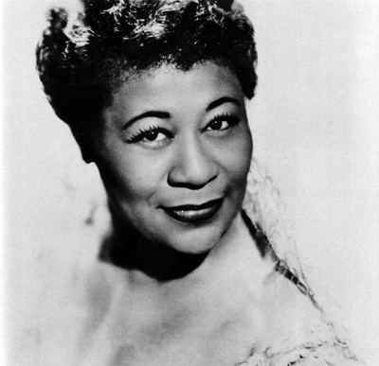
Just don't give up trying to do what you really want to do. Where there is love and inspiration, I don't think you can go wrong.
Ella Fitzgerald

Slide 13
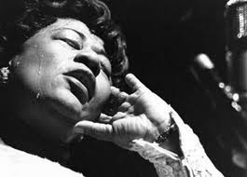
The only thing better than singing is more singing.
Ella Fitzgerald

Slide 14
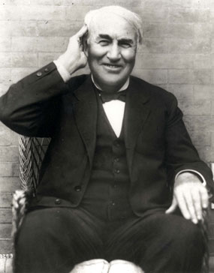
Be courageous. I have seen many depressions in business. Always America has emerged from these stronger and more prosperous. Be brave as your fathers before you. Have faith! Go forward!
Thomas A. Edison

Slide 15
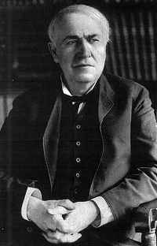
Genius is one percent inspiration and ninety-nine percent perspiration.
Thomas A. Edison

Slide 16
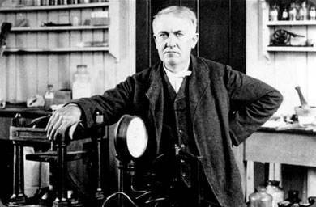
I have friends in overalls whose friendship I would not swap for the favor of the kings of the world.
Thomas A. Edison

Slide 17
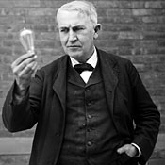
I have not failed. I've just found 10,000 ways that won't work.
Thomas A. Edison

Slide 18
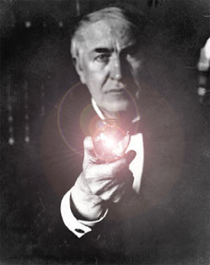
Just because something doesn't do what you planned it to do doesn't mean it's useless.
Thomas A. Edison

Slide 19
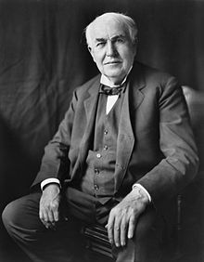
One might think that the money value of an invention constitutes its reward to the man who loves his work. But... I continue to find my greatest pleasure, and so my reward, in the work that precedes what the world calls success.
Thomas A. Edison

Slide 20
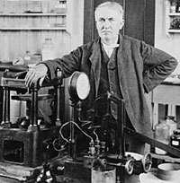
Our greatest weakness lies in giving up. The most certain way to succeed is always to try just one more time.
Thomas A. Edison

Slide 21
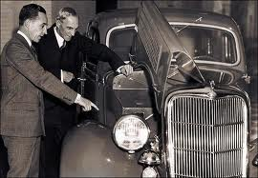
Anyone who stops learning is old, whether at twenty or eighty. Anyone who keeps learning stays young. The greatest thing in life is to keep your mind young.
Henry Ford

Slide 22
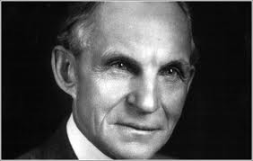
Coming together is a beginning; keeping together is progress; working together is success.
Henry Ford

Slide 23
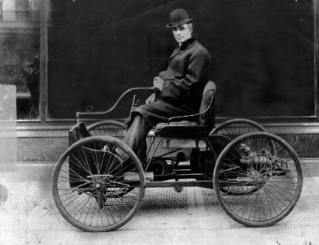
Failure is simply the opportunity to begin again, this time more intelligently.
Henry Ford

Slide 24
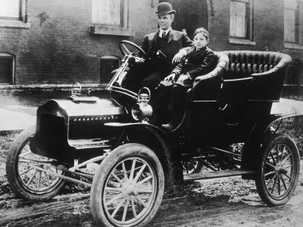
If money is your hope for independence you will never have it. The only real security that a man will have in this world is a reserve of knowledge, experience, and ability.
Henry Ford

Slide 25
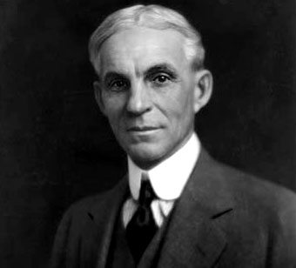
You can't build a reputation on what you are going to do.
Henry Ford

Slide 26
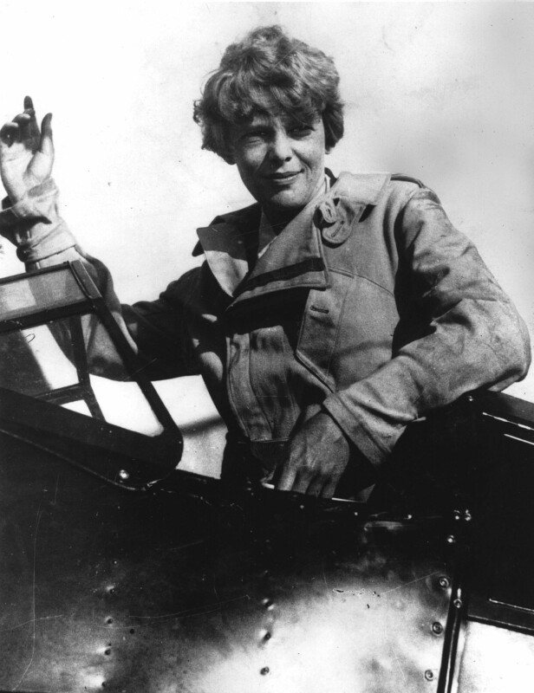
In soloing - as in other activities - it is far easier to start something than it is to finish it.
Amelia Earhart

Slide 27
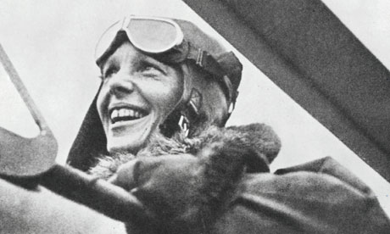
Never interrupt someone doing what you said couldn't be done.
Amelia Earhart

Slide 28
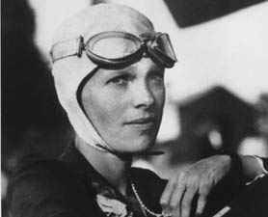
Please know that I am aware of the hazards. I want to do it because I want to do it. Women must try to do things as men have tried. When they fail, their failure must be a challenge to others.
Amelia Earhart

Slide 29
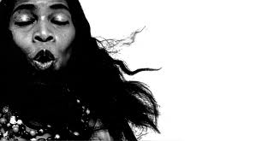
As long as you keep a person down, some part of you has to be down there to hold him down, so it means you cannot soar as you otherwise might.
Marian Anderson

Slide 30
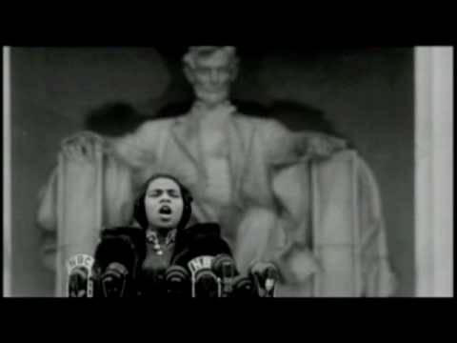
I forgave the DAR many years ago. You lose a lot of time hating people.
Marian Anderson

Slide 31
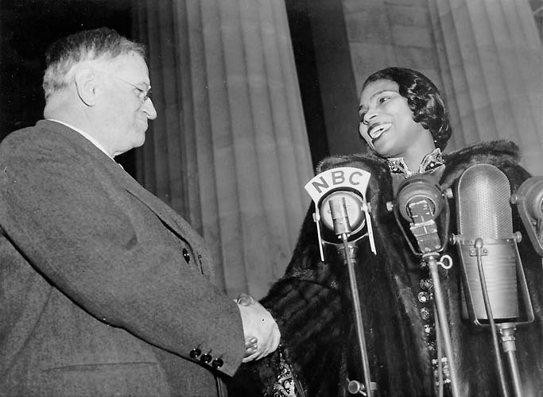
None of us is responsible for the complexion of his skin. This fact of nature offers no clue to the character or quality of the person underneath.
Marian Anderson

Slide 32
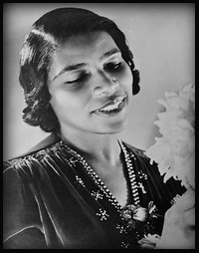
Prejudice is like a hair across your cheek. You can't see it, you can't find it with your fingers, but you keep brushing at it because the feel of it is irritating.
Marian Anderson

Slide 33
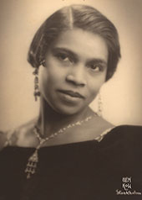
There are many persons ready to do what is right because in their hearts they know it is right. But they hesitate, waiting for the other fellow to make the make the first move - and he, in turn, waits for you.
Marian Anderson

